Slide 1
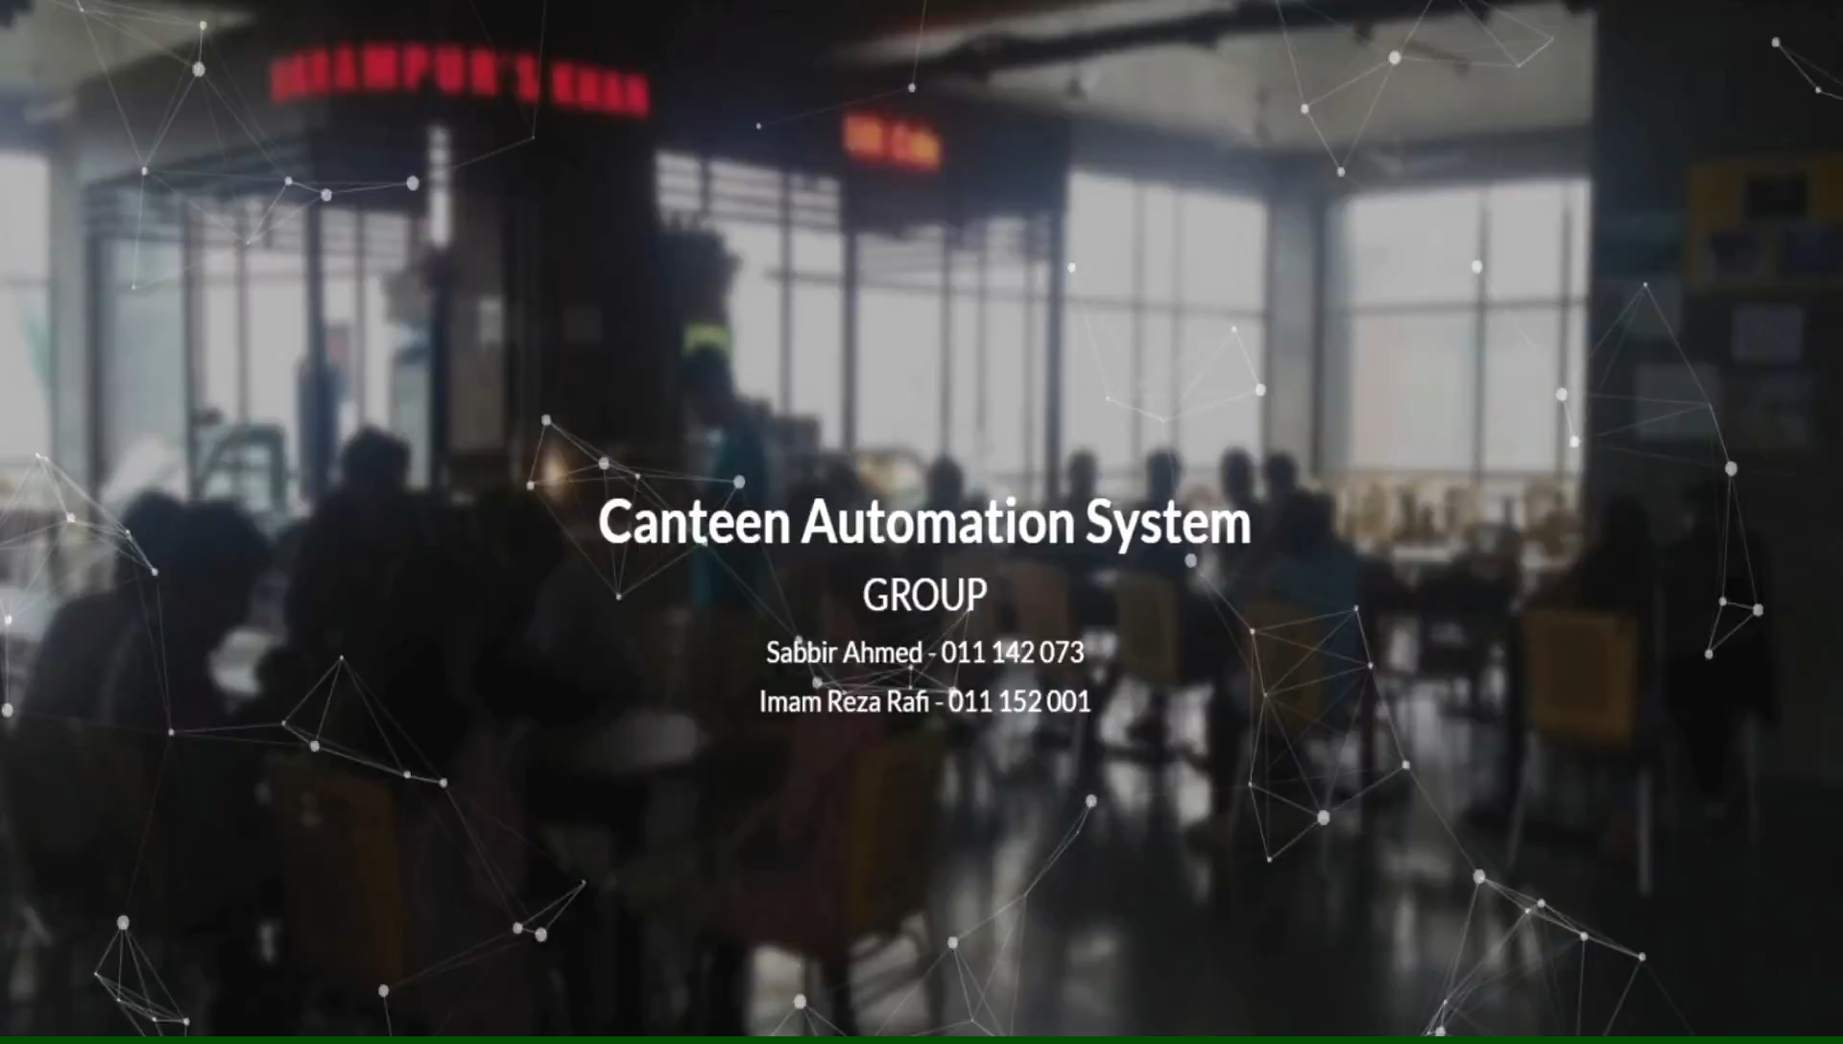

Slide 2
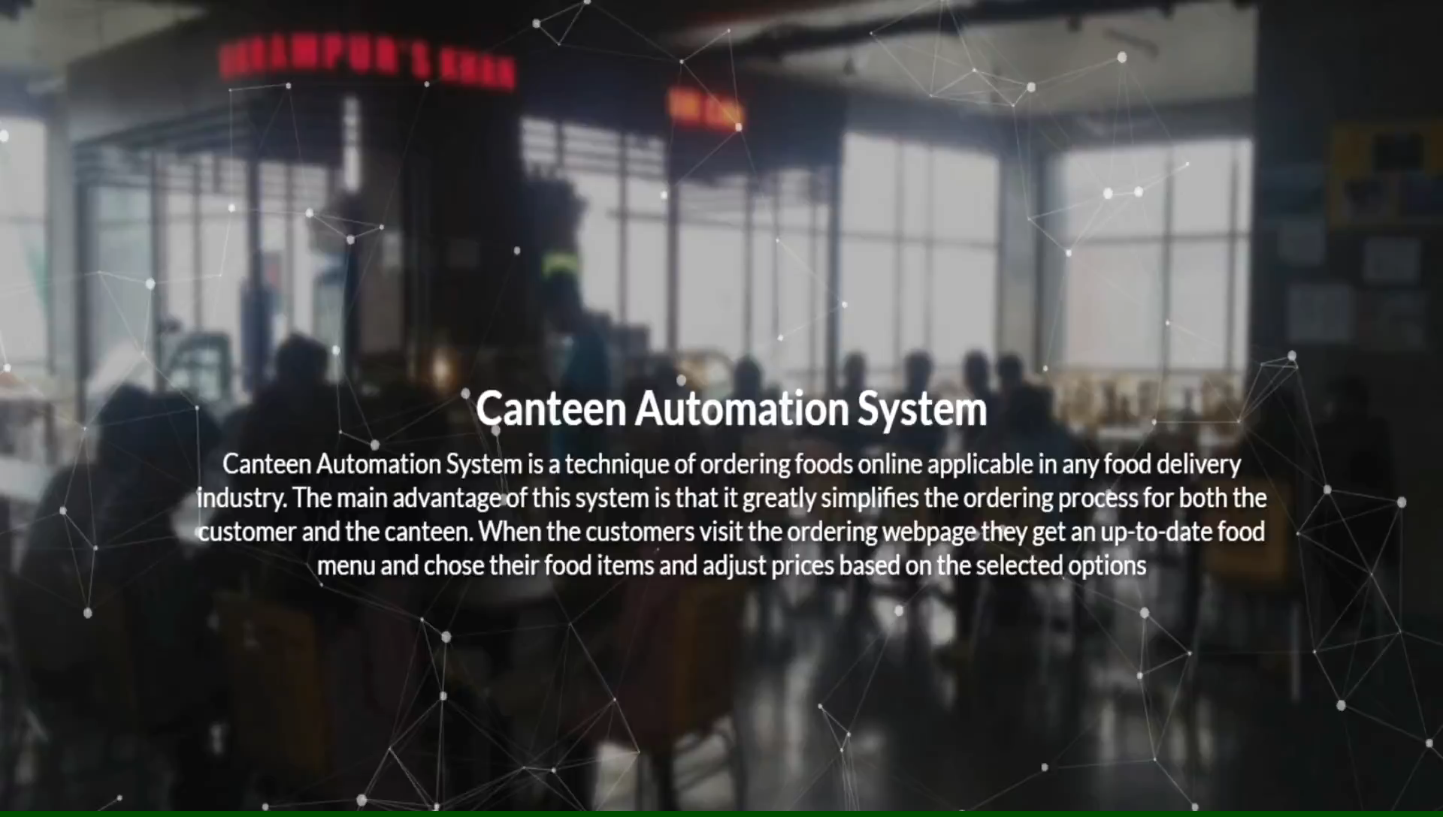

Slide 3
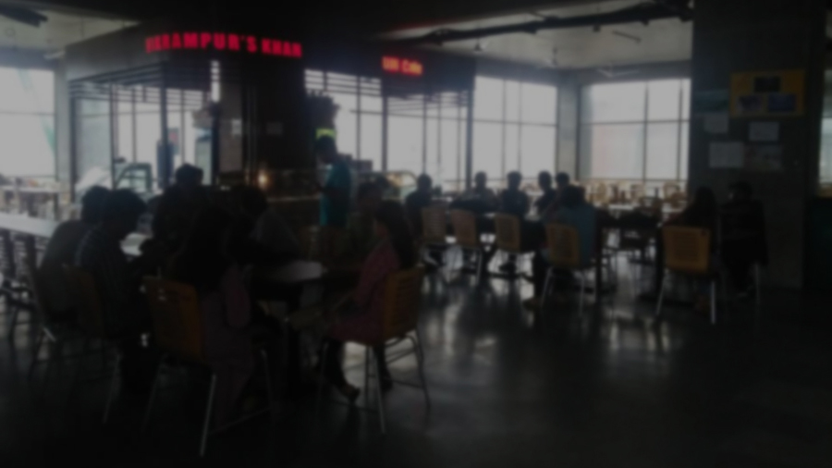
Features
1. Automated online ordering of foods in a canteen.
2. Up-to-date food menu, Choose food items.
3. Adjust prices based on selected options.
4. Simplifies the ordering process for both the
customer and the canteen.

Slide 4
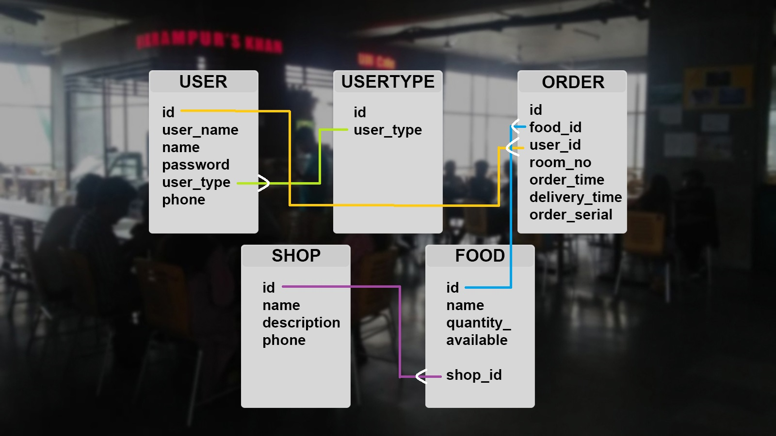
ER DIAGRAM

Slide 5
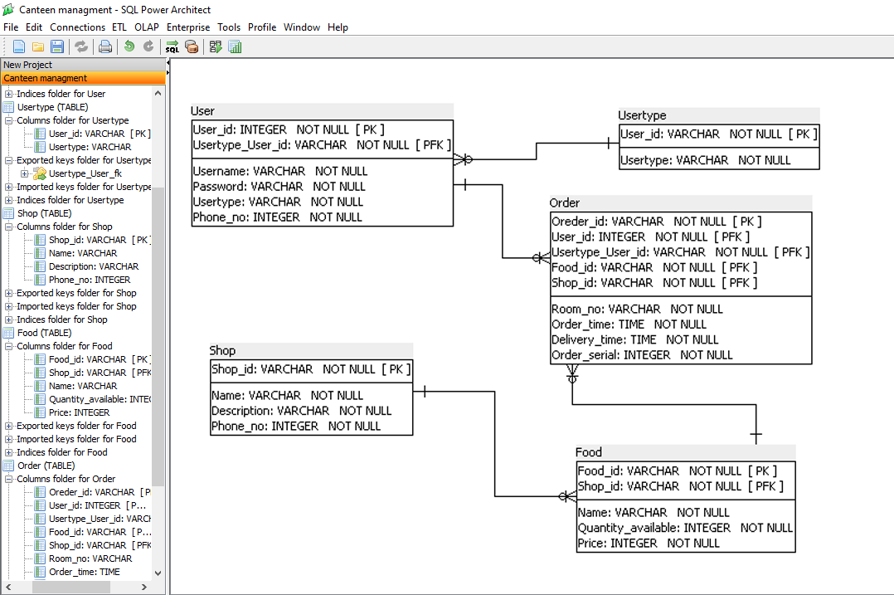
ER Diagram

Slide 6
THANK YOU !!

